Slide 1


Protecting our business together!

Slide 2
Advancement of technology and digitalization has made cybercrime
more prevalant than ever before.
From data breaches to phishing scams, there's been a significant rise in cyberattacks where hackers exploit our vulnerabilities to steal sensitive information to carry out malicious activities like financial frauds and identity theft.

Slide 3
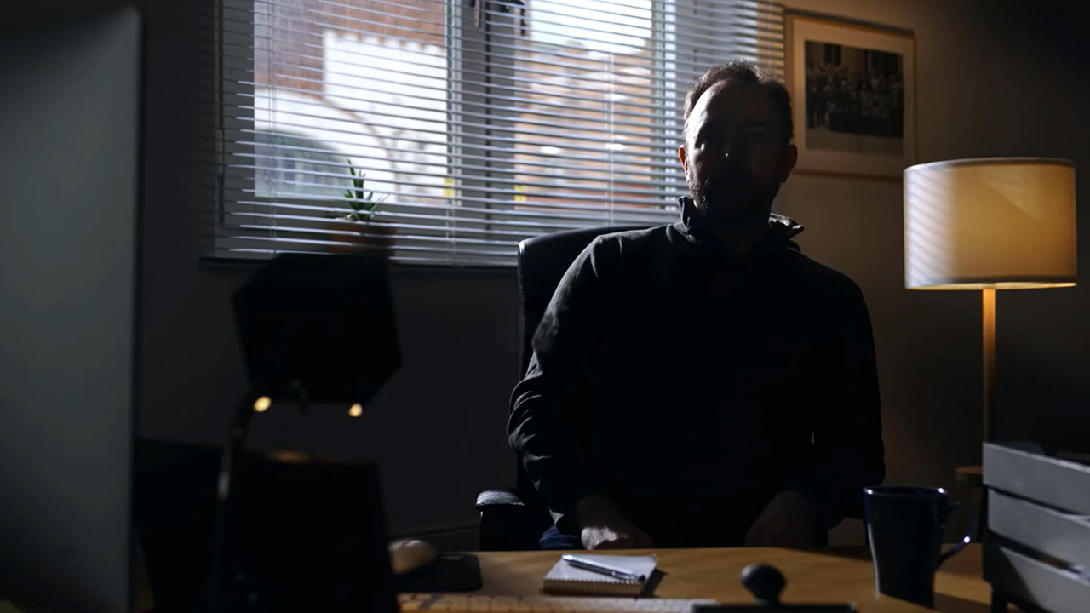
Watch the story of a cyberattack
“It was, by far, the most challenging
crisis that I have handled in my career.”
Click here to visit the Be Aware website to watch the video

Slide 4
Now you know how devastating the consequences of a real cyber attack can be.
But who's responsible to prevent this? All of us!
You and I are the best line of defense against cybercrime, not the technology.

Slide 5
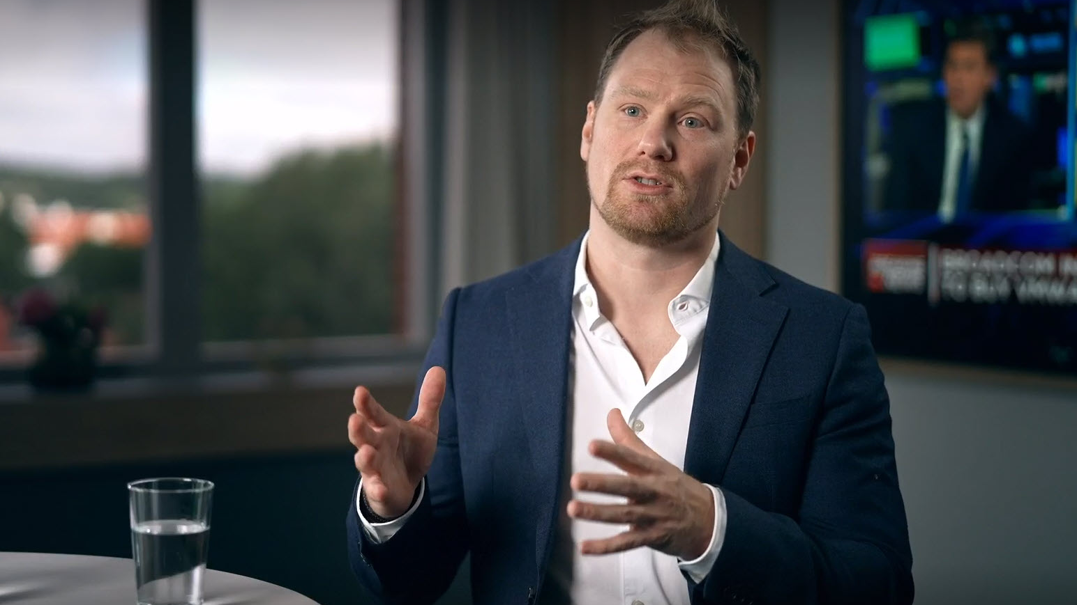
Watch an ethical hacker’s story
“Who is responsible for locking the door in your house?
Only you, or the whole family?”
Click here to visit the Be Aware website to watch the video

Slide 6
95% of all security breaches are caused by a human error!
This underscores the need for attention across all levels, not just within the
IT department. It demands preparedness and awareness from every individual.
This is where we would like to encourage you to take proactive steps.

Slide 7




Test your employees
Test how your employees react on a simulated phishing email. This program compares your employees’ likeliness of responding to a phishing attack against other organizations.
Phishing
simulation
Choice of
participants
Benchmarking
report
Funded by Volvo Group

Slide 8



Evaluate your security posture
Evaluate your security posture by completing two surveys featuring simple YES/NO questions.
The first assesses your organization’s security maturity, while the second evaluates your IT readiness, scrutinizing the security maturity of your IT environment.
Security
Maturity
IT
Readiness
Funded by Volvo Group

Slide 9




Participate in a
Security Awareness Program
Strengthen your defense and reduce the risk of security breaches by engaging in a Security Awareness Program.
These programs come with a cost but is a valuable investment for you and your organization.
There are many suppliers to choose from on the market.
This is what you usually get when investing in a
Security Awareness Program:
Online
trainings
Phishing
simulation
Phish
service
Follow-up
Reports
Charged service

Slide 10
Cyber threat is real,
but so is our power to protect our business.

Slide 11


